Slide 1
Semantic Road Segmentation
Guide
Prof. C Krishna Mohan
By
D V K M Rishab
AI20MTECH14004
&
Shubham Kumar Dubey
CS20RESCH13001
Mentor
K Naveen Kumar
PhD Research Scholar

Slide 2
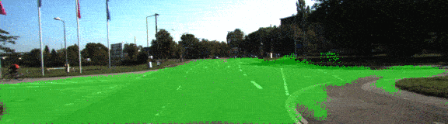
What is Road Segmentation?

Slide 3
What is Road Segmentation?(contd…)
Autonomous vehicles
Separating roads and other surroundings
Traffic management
Handicap assist

Slide 4
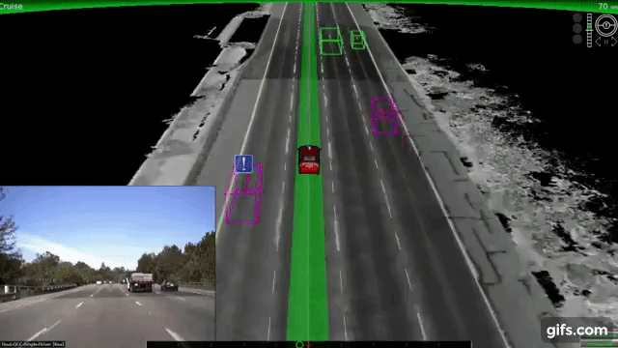
Motivation
Safety
Optimal traffic management
Computer vision prospect
Future

Slide 5
Overview of the implemented work
Problem Statement
Datasets
Technology stack
Network architecture
Evaluation

Slide 6
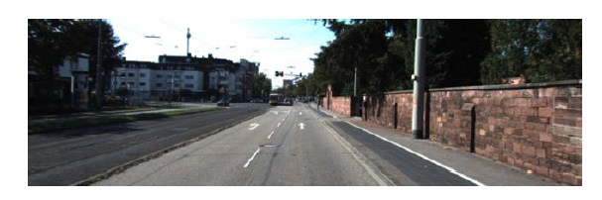
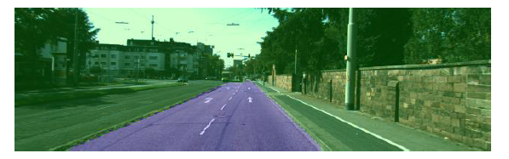
Overview of the implemented work(contd…)
Input image
Output image

Slide 7
Problem Statement
Convolutional Neural Network(CNN)
Input domain is monocular camera images of road conditions
Number of tunable parameters
15.8 million for the UNet based on a ResNet 18 encoder
37.6 million for the UNet based on a ResNet 50 encoder
Transfer learning with ResNet encoder weights trained on ImageNet

Slide 8
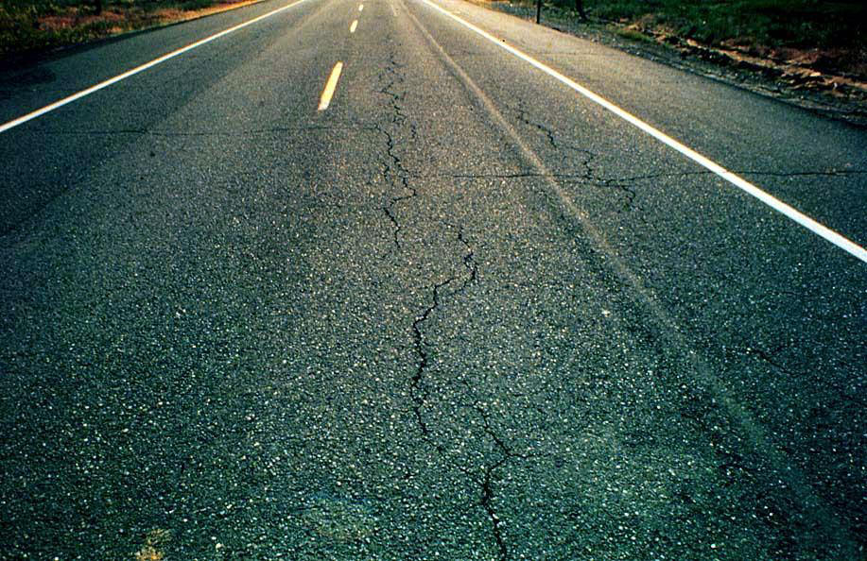
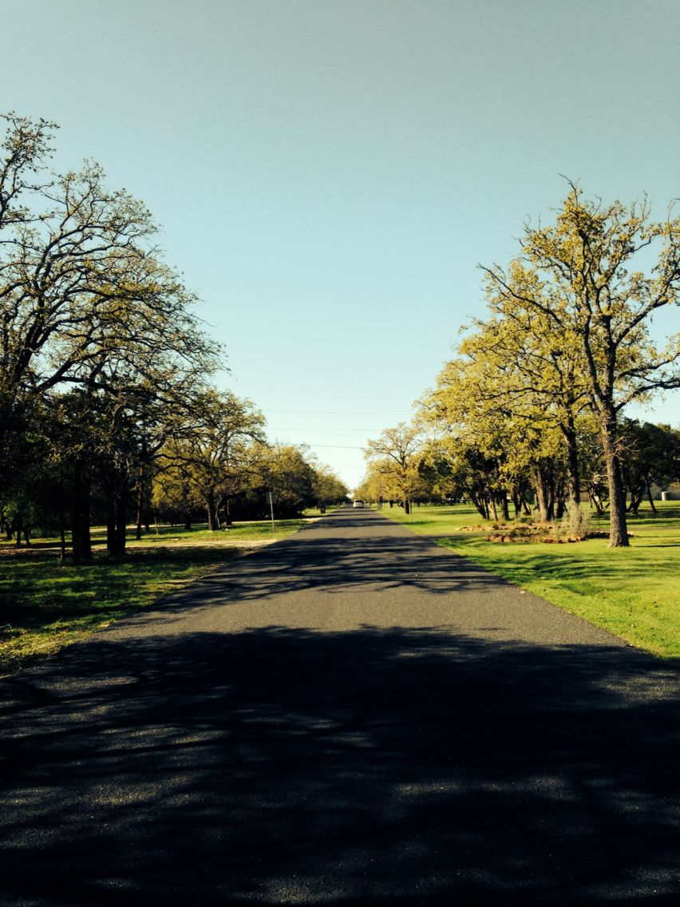
Problem Statement(contd…)
Should work on varying road conditions

Slide 9
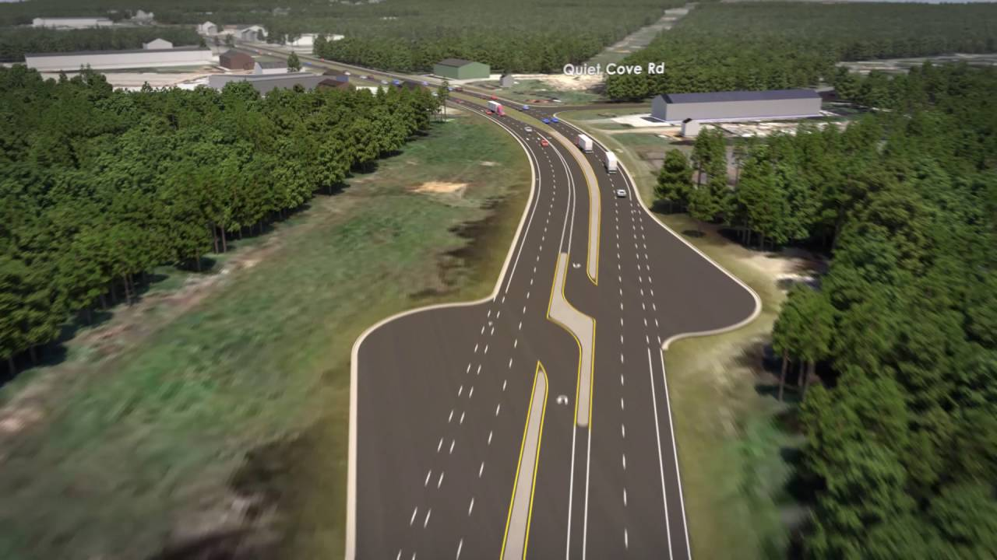
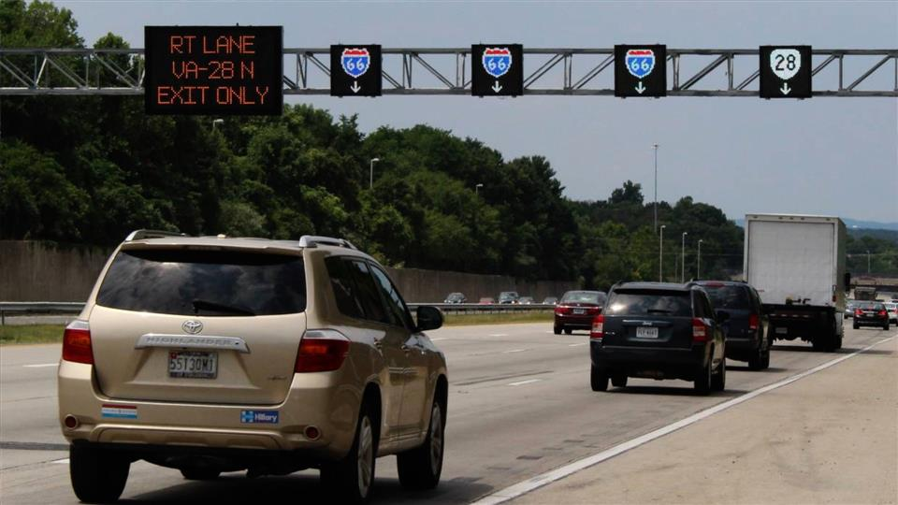
Problem Statement(contd…)
Should work on varying road conditions

Slide 10
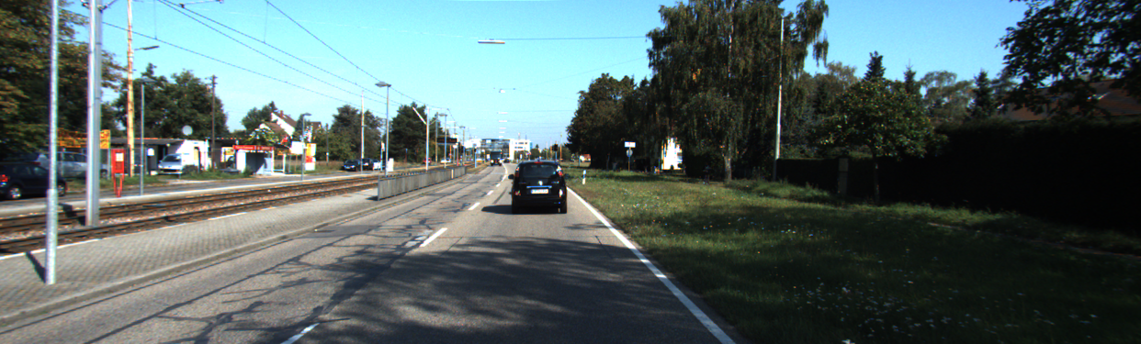
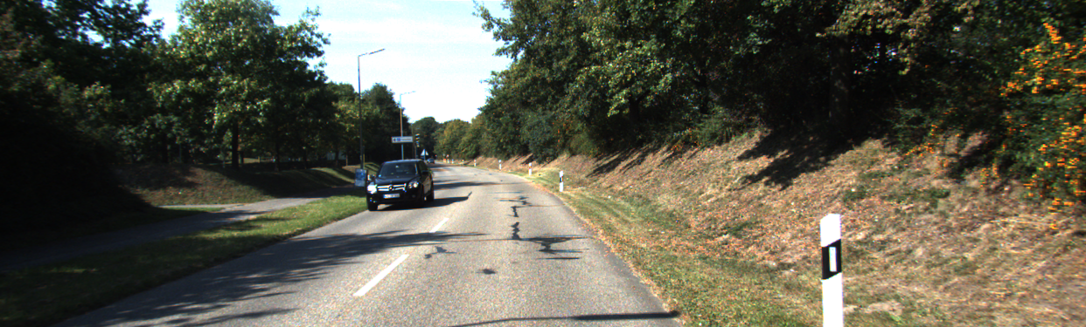
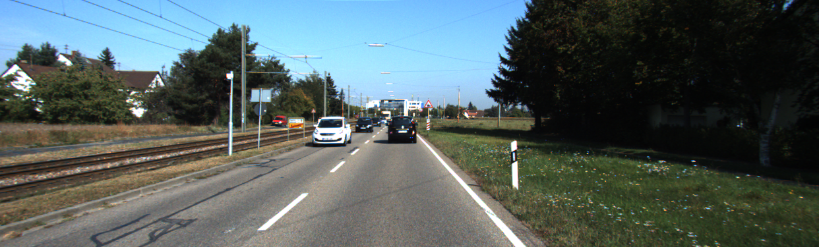
Understanding the datasets
KITTI Dataset
Karlsruhe Institute of Technology and Toyota Technological Institute at Chicago
KITTI Road/Lane Detection Evaluation 2013
289 training and 290 test images
Image augmentation techniques -rotation, Gaussian noise, and random dropout, improves dataset robustness

Slide 11
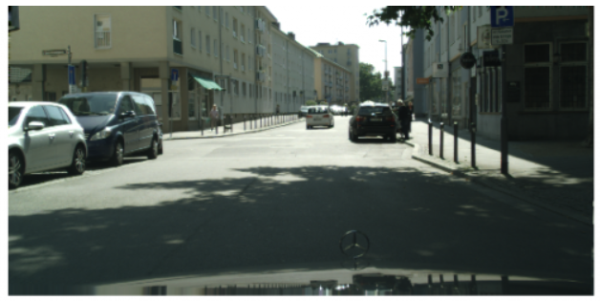
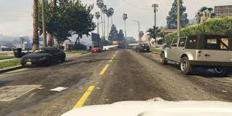
Understanding the datasets(contd…)
Berkeley DeepDrive
state-of-the-art technologies in computer vision, robotics, for automotive applications
proposed by UC Berkeley faculty
largest open driving video dataset with 100K videos
geographic, environmental, and weather diversity, for training models aware of all possible cases.

Slide 12
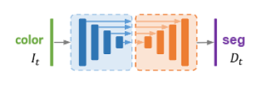
Network Architecture
standard fully convolutional UNet
encoder-decoder network with skip connections

Slide 13
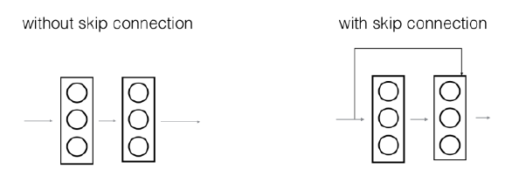
Network Architecture(contd…)
contraction, bottleneck, and expansion
encoder, decreases spatial dimensions but increasing in feature dimensions
decoder, reduces the image in feature dimension increasing the spatial dimensions
skip connections that allow it to tap into the same-sized output of the contraction section

Slide 14
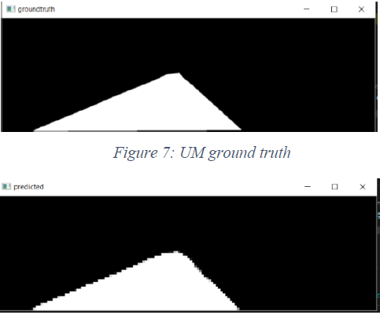
Working Principle
ResNet model because it allows us to train a deep neural network and reduces the risk of the vanishing gradient problem
ImageNet
the contraction, bottleneck, and expansion

Slide 15
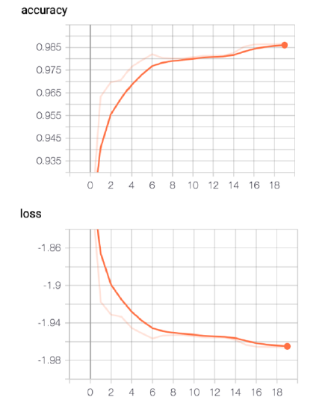
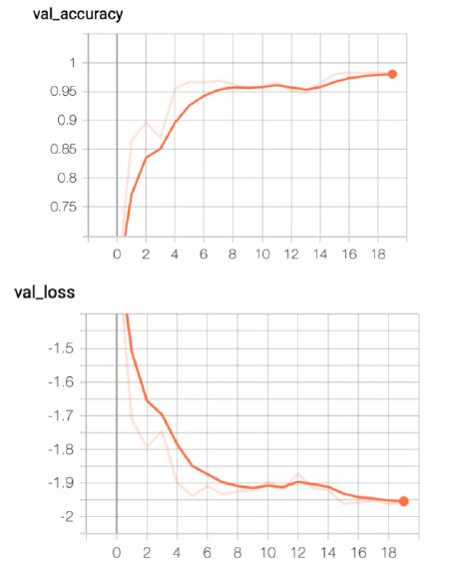
Performance Evaluation
We show here the accuracy and loss on the training and validation sets.
Training set accuracy and loss
Validation set accuracy and loss

Slide 16
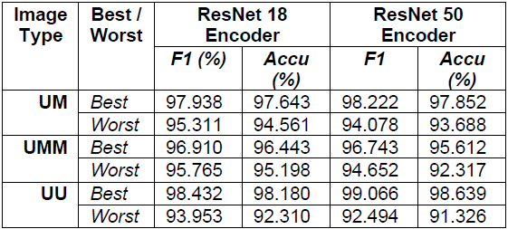
Performance Evaluation(contd…)
F1 score in best case was 99.1% and accuracy is 98.6%; in worse case, the F1 score was 92.5% and accuracy is 91.3%

Slide 17
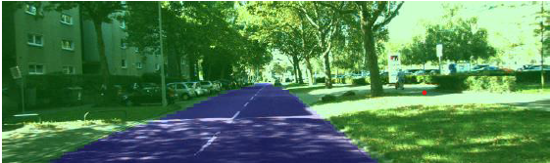
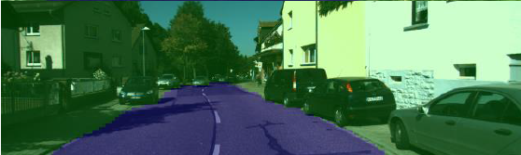
Performance Evaluation(contd…)
Case study
Our implementation works in various and adverse road conditions
Case Study 1
Irregular shadows
Case Study 2
Cracks and road curvature

Slide 18
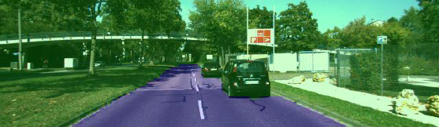
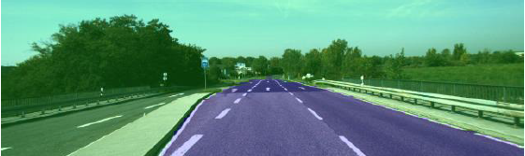
Performance Evaluation(contd…)
Case study
Our implementation works in various and adverse road conditions
Case Study 3
Multiple cars
Case Study 4
Lane widening

Slide 19
Challenges
Encountered in the segmentation ground truth and was fixed by producing a binary one-hot segmentation for each pixel from the ground truth data
Ground truth data for the testing dataset was not available for users to download
Use weights pre-trained on the road dataset to fine tune with the limited lane marking dataset.

Slide 20
References
Gon Cheng, Yue Wang, Yiming Qian, James H. Elder “Geometry-guided adaptation for Road Segmentation", in CRV(The Computer and Robot vision Conference)vol. 1, pages: 46-53, 2020.
Man Yuan, Zhi Liu, Fan Wang and Fei Jin, “Rethinking labeling in road segmentation", in International journal of remote sensing, Volume 40, 2019.
V.H. Mistry and R.M Makwana, “Road segmentation and tracking on Indian road scenes", in International journal of Computer aided Engineering and Technology, Volume 11 No.4/5, 2019.

Slide 21
THANK YOU!

